Slide 1
Chapter 7
Basic Processing Unit
(Hamacher)
BIDYUT KUMAR PATRA
24.03.2020
(10.00 AM-10.55 AM)

Slide 2
Objectives
How a processor executes an instruction
The internal functional units of a processor and how they are interconnected
How to generate control signals

Slide 3
Few Fundamental Concepts

Slide 4
Typical Operating Steps
Programs reside in the memory through input devices
PC is set to point to the first instruction
The contents of PC are transferred to MAR
A Read signal is sent to the memory
The first instruction is read out and loaded into MDR
The contents of MDR are transferred to IR
Decode and execute the instruction

Slide 5
Fundamental Concepts
Processor fetches one instruction at a time and perform the operation specified.
Instructions are fetched from successive memory locations until a branch or a jump instruction is encountered.
Processor keeps track of the address of the memory location containing the next instruction to be fetched using Program Counter (PC).
Instruction Register (IR) holds the instruction.

Slide 6
Executing an Instruction
Fetch the contents of the memory location pointed to by the PC. The contents of this location are loaded into the IR (fetch phase).
IR ← [PC]
Increment the contents of the PC by 4 (fetch phase). (Assuming that the memory is byte addressable and length of each instruct is 4 bytes)
PC ← PC + 4
Carry out the actions specified by the instruction in the IR (execution phase).

Slide 7
Functional Units
Arithmetic
Input
and
logic
Memory
Output
Control
I/O
Processor
Figure 1.1. Basic functional units of a computer.

Slide 8
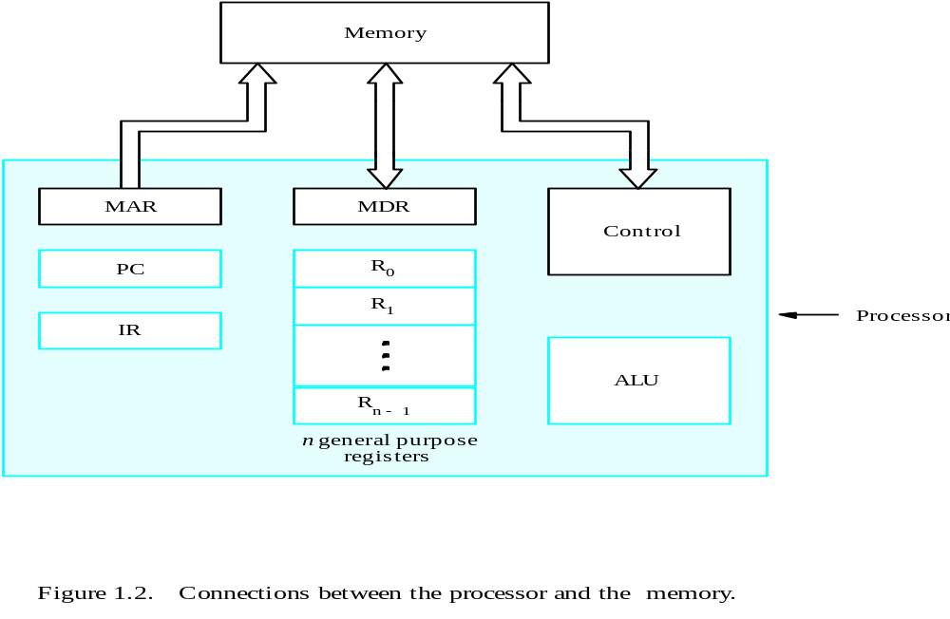
Connection between the Processor and the Memory

Slide 9
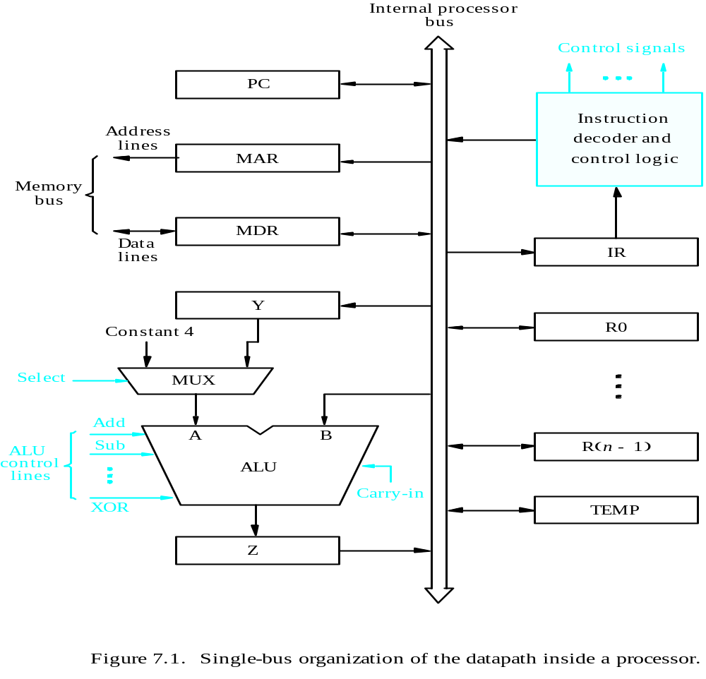
Processor Organization (Single bus)
MDR HAS TWO INPUTS AND TWO OUTPUTS
Datapath
Page 413

Slide 10
Executing an Instruction
Transfer a word of data from one processor register to another or to the ALU. (Register Transfer)
Perform an arithmetic or a logic operation and store the result in a processor register.
Fetch the contents of a given memory location and load them into a processor register.
Store a word of data from a processor register into a given memory location.

Slide 11
Register Transfers
Internal processor
b
us
R
i
in
R
i
R
i
out
Y
in
Y
Constant 4
Select
MUX
A
B
ALU
Z
in
Z
Z
out
Figure 7.2. Input and output gating for the registers in Figure 7.1.

Slide 12
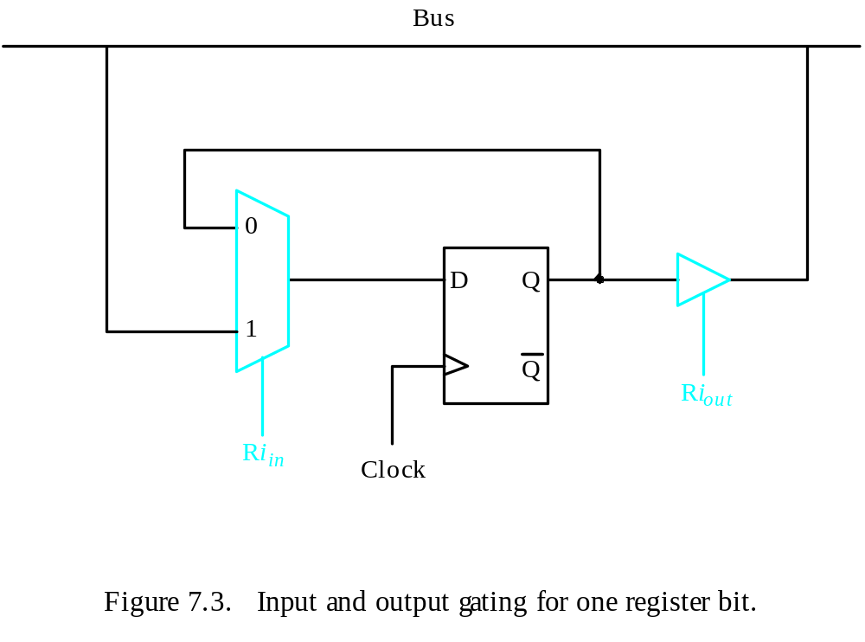
Register Transfers
All operations and data transfers are controlled by the processor clock.
Figure 7.3. Input and output gating for one register bit.

Slide 13
Register Transfers R4 ← R1
        Enable the output gate of R1 by setting R1_{out=1}. (Content of R1 on common bus)
        Enable the input gate of R4 by setting R4_{in=1}.
R1_{out=1,} R4_{in=1}

Slide 14
Performing an Arithmetic or Logic Operation
The ALU is a combinational circuit that has no internal storage.
ALU gets the two operands from MUX and bus. The result is temporarily stored in register Z.

Slide 15
Processor Organization (Single bus)
MDR HAS TWO INPUTS AND TWO OUTPUTS
Datapath
Page 413

Slide 16
Performing an Arithmetic or Logic Operation
What is the sequence of operations to add the contents of register R1 to those of R2 and store the result in R3?
R3 ←R1+R2

Slide 17
Processor Organization (Single bus)
MDR HAS TWO INPUTS AND TWO OUTPUTS
Datapath
R3 ←R1+R2

Slide 18

R3 ←R1+R2

Slide 19
Performing an Arithmetic or Logic Operation
R3 ←R1+R2
  R1out, Yin
  R2out, SelectY, Add, Zin
  Zout, R3in

Slide 20
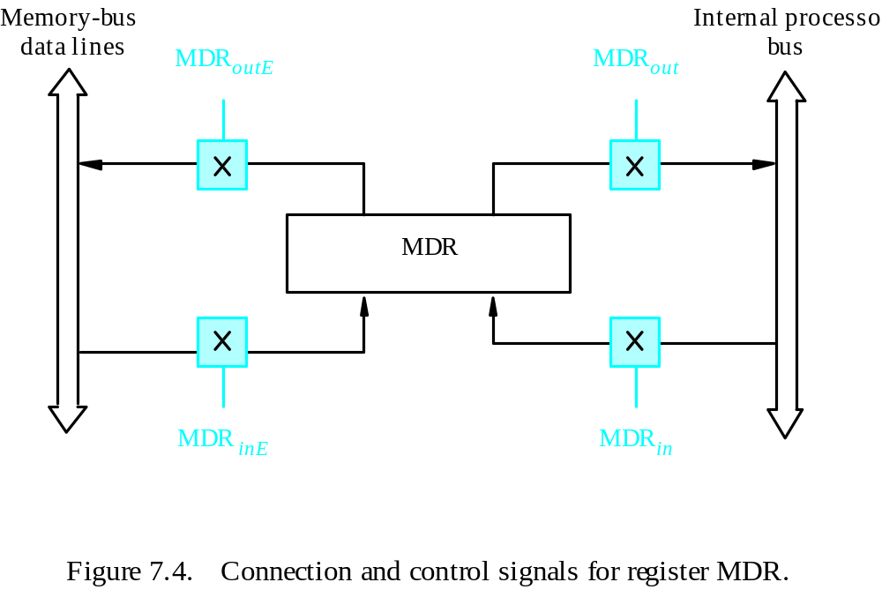
Fetching a Word from Memory
Address into MAR; issue Read operation; data into MDR.
Figure 7.4. Connection and control signals for register MDR.

Slide 21
Fetching a Word from Memory
To accommodate this, the processor waits until it receives an indication that the requested operation has been completed (Memory-Function-Completed, MFC).
Move (R1), R2
MAR ← [R1]
Start a Read operation on the memory bus
Wait for the MFC response from the memory
Load MDR from the memory bus
R2 ← [MDR]

Slide 22
Fetching a Word from Memory
Move (R1), R2
MAR ← [R1]
Start a Read operation on the memory bus
Wait for the MFC response from the memory
Load MDR from the memory bus
R2 ← [MDR]
Step 1. R1_{out,} MAR_{in,} Read
Step 2. WMFC, MDR_{InE}
Step 3. MDR_{out,} R2_{in}

Slide 23
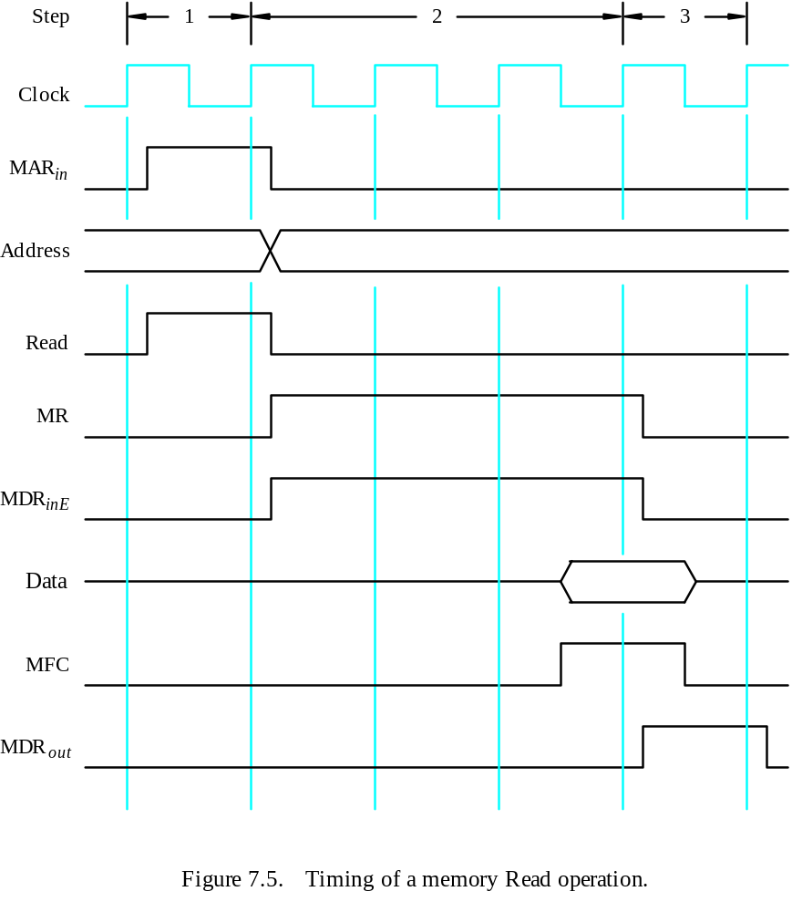
Timing
MAR ← [R1]
Assume MAR
is always available
on the address lines
of the memory bus.
Start a Read operation on the memory bus
Wait for the MFC response from the memory
Load MDR from the memory bus
R2 ← [MDR]

Slide 24
Storing a Word in Memory
Move R1, (R2)
MAR ← [R2]
MDR ←R1, Write Operation Initiate.
Wait for the MFC response from the memory
Step 1. R2_{out,} MAR_{in,}
Step 2. R1_{out,} MDR_{in,} Write
Step 3. MDR_{outE,} WMFC

Slide 25
Execution of a Complete Instruction
Add (R3), R1
Fetch the instruction
Fetch the first operand (the contents of the memory location pointed to by R3)
Perform the addition
Load the result into R1

Slide 26
Architecture
Internal processor
b
us
R
i
in
R
i
R
i
out
Y
in
Y
Constant 4
Select
MUX
A
B
ALU
Z
in
Z
Z
out
Figure 7.2. Input and output gating for the registers in Figure 7.1.

Slide 27
Execution of a Complete Instruction
Add (R3), R1

Slide 28
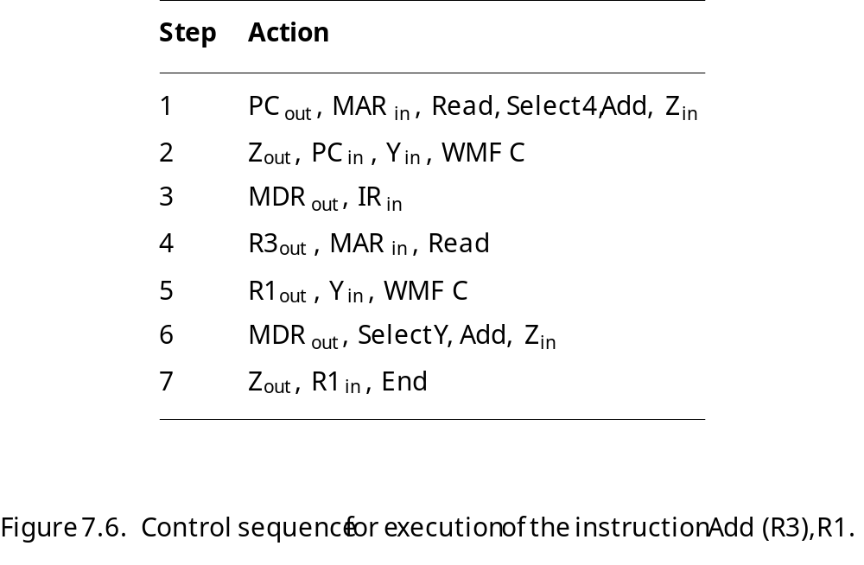
Execution of a Complete Instruction
Add (R3), R1

Slide 29
Execution of Branch Instructions
A branch instruction replaces the contents of PC with the branch target address, which is usually obtained by adding an offset X given in the branch instruction.
The offset X is usually the difference between the branch target address and the address immediately following the branch instruction.
Conditional branch

Slide 30
Execution of Branch Instructions
Step
Action
1
PC
out
,
MAR
in
,
Read,
Select4,
Add,
Z
in
2
Z
out
,
PC
in
,
Y
in
,
WMF
C
3
MDR
out
,
IR
in
4
Offset-field-of-IR
out
,
Add,
Z
in
5
Z
out
,
PC
in
,
End
Figure 7.7. Control sequence for an unconditional branch instruction.

Slide 31
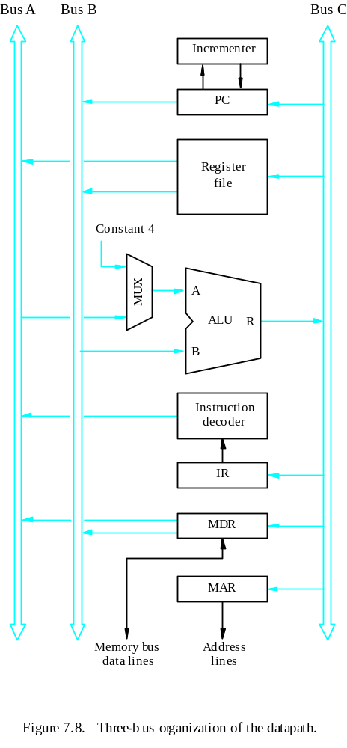
Multiple-Bus Organization

Slide 32
Multiple-Bus Organization
Add R4, R5, R6
Step
Action
1
PC
out
,
R=B,
MAR
in
,
Read,
IncPC
2
WMF
C
3
MDR
outB
,
R=B,
IR
in
4
R4
outA
,
R5
outB
,
SelectA,
Add,
R6
in
,
End
Figure 7.9. Control sequence for the instruction. Add R4,R5,R6,
for the three-bus organization in Figure 7.8.

Slide 33
Quiz
What is the control sequence for execution of the instruction
Add R1, R2
including the instruction fetch phase? (Assume single bus architecture)

Slide 34
Hardwired Control

Slide 35
Overview
To execute instructions, the processor must have some means of generating the control signals needed in the proper sequence.
Two categories: hardwired control and microprogrammed control
Hardwired system can operate at high speed; but with little flexibility.

Slide 36
Control Unit Organization
Clock
CLK
Control step
counter
External
inputs
Decoder/
IR
encoder
Condition
codes
Control signals
Figure 7.10. Control unit organization.

Slide 37
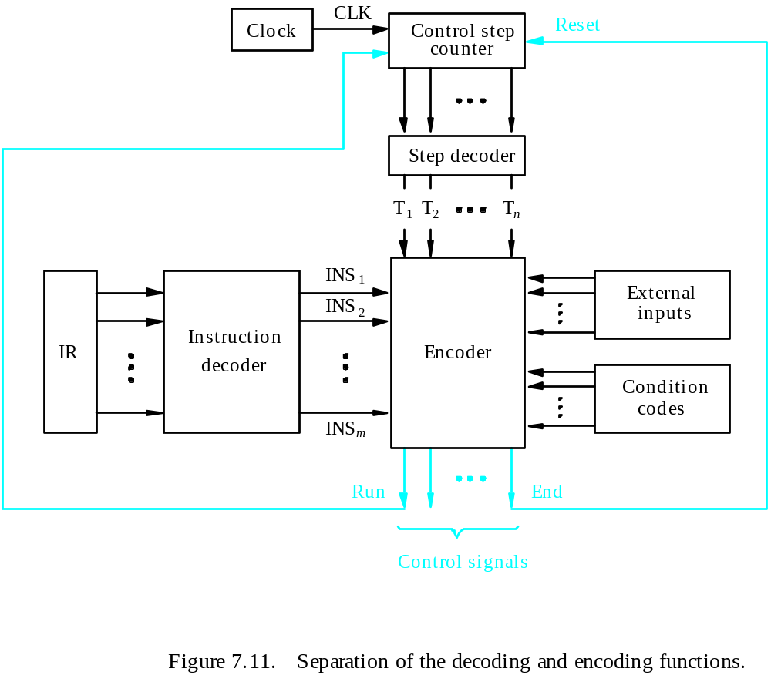
Detailed Block Description

Slide 38
Generating Z_{in}
Z_{in} = T₁ + T₆ • ADD + T₄ • BR + …
Branch
Add
T
4
T
6
T
1
Figure 7.12. Generation of the Z_{in} control signal for the processor in Figure 7.1.

Slide 39
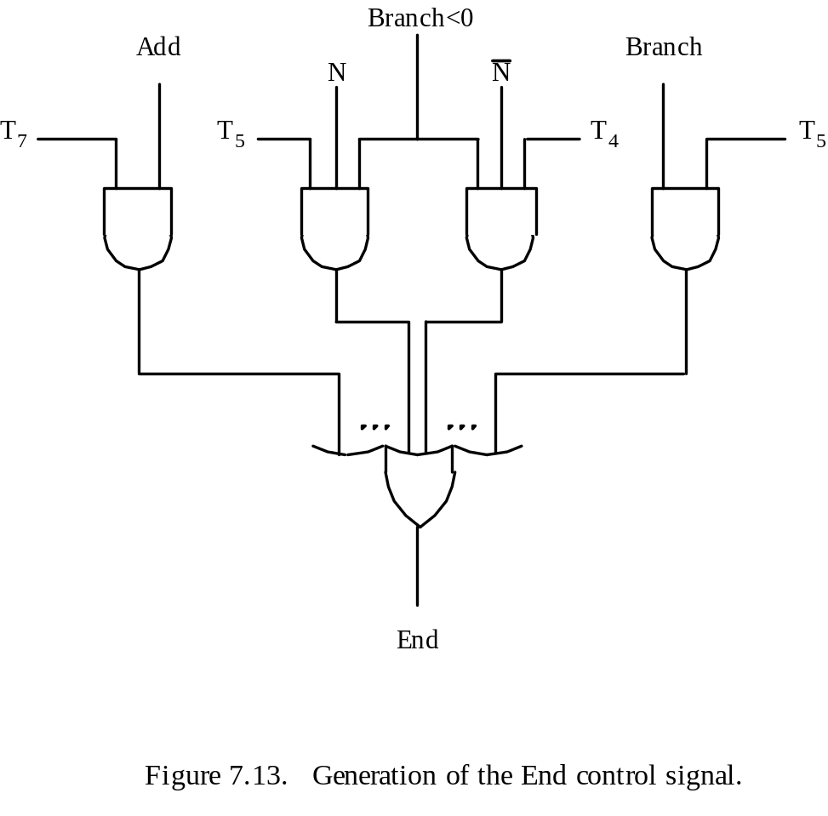
Generating End
End = T₇ • ADD + T₅ • BR + (T₅ • N + T₄ • N) • BRN +…

Slide 40
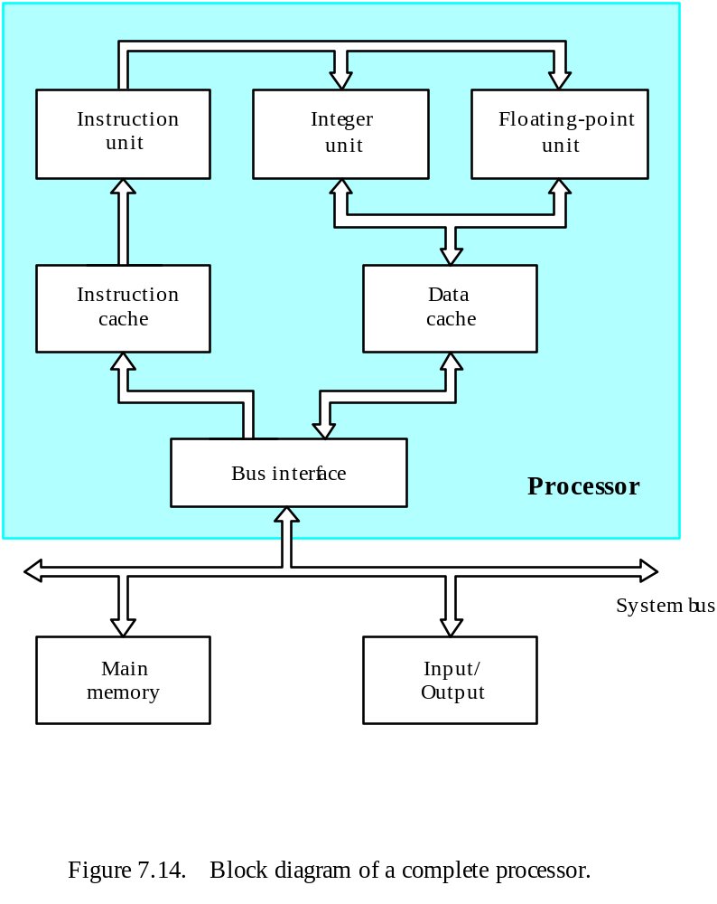
A Complete Processor

Slide 41
Microprogrammed Control

Slide 42
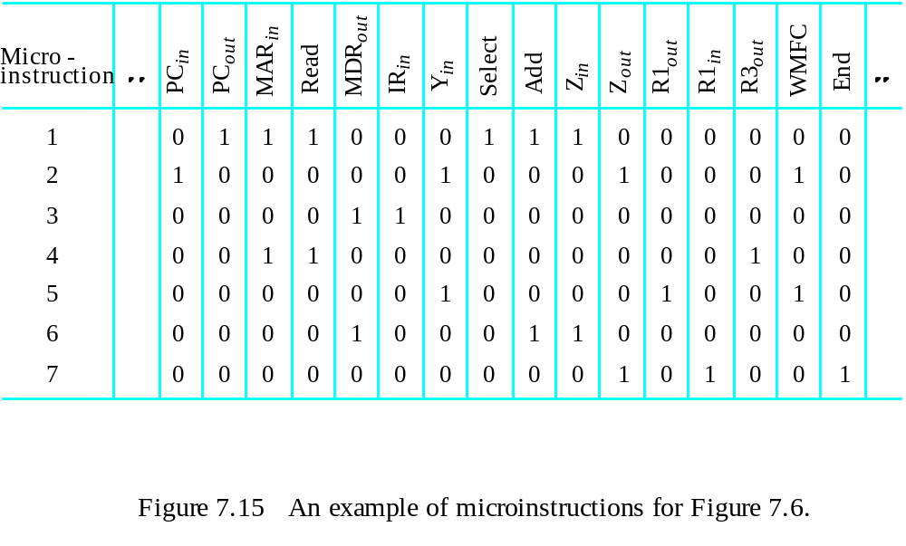
Overview
Control signals are generated by a program similar to machine language programs.
Control Word (CW); microroutine; microinstruction

Slide 43
Overview

Slide 44
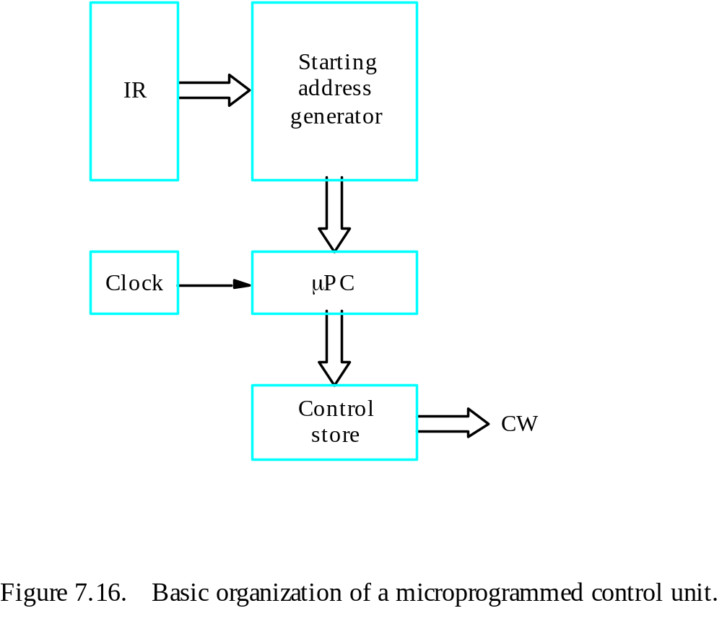
Overview
Control store
One function
cannot be carried
out by this simple
organization.

Slide 45
Overview
The previous organization cannot handle the situation when the control unit is required to check the status of the condition codes or external inputs to choose between alternative courses of action.
Use conditional branch microinstruction.
Address
Microinstruction
0
PC
out
,
MAR
in
,
Read,
Select4,
Add,
Z
in
1
Z
out
,
PC
in
,
Y
in
,
WMF
C
2
MDR
out
,
IR
in
3
Branch
to
starting
address
of
appropriate
microroutine
.
.
.
.
.
.
.
.
.
.
.
.
.
.
.
.
.
.
.
.
.
.
.
.
.
.
.
.
.
.
.
.
.
.
.
.
.
.
.
.
.
.
.
.
.
.
.
.
.
.
.
.
.
.
.
.
.
.
.
.
.
.
.
.
.
.
25
If
N=0,
then
branch
to
microinstruction
0
26
Offset-field-of-IR
out
,
SelectY,
Add,
Z
in
27
Z
out
,
PC
in
,
End
Figure 7.17. Microroutine for the instruction Branch<0.

Slide 46
Overview
External
inputs
Starting and
Condition
IR
branch address
codes
generator
Clock
μ
P
C
Control
CW
store
Figure 7.18. Organization of the control unit to allow
conditional branching in the microprogram.

Slide 47
Microinstructions
A straightforward way to structure microinstructions is to assign one bit position to each control signal.
However, this is very inefficient.
The length can be reduced: most signals are not needed simultaneously, and many signals are mutually exclusive.
All mutually exclusive signals are placed in the same group in binary coding.

Slide 48
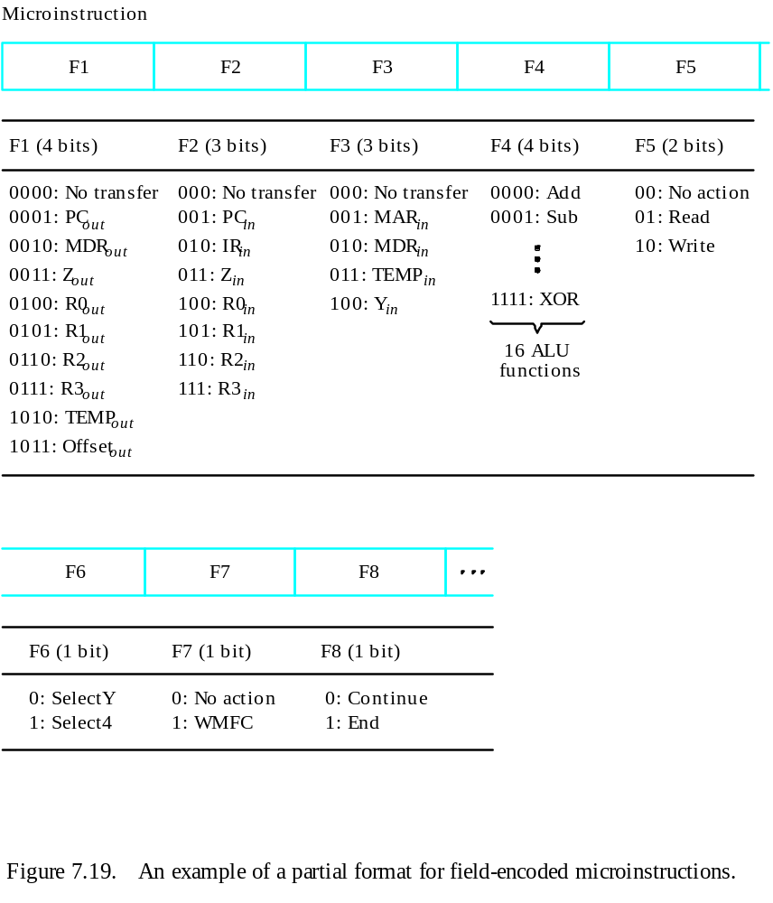
Partial Format for the Microinstructions
What is the price paid for
this scheme?

Slide 49
Further Improvement
Enumerate the patterns of required signals in all possible microinstructions. Each meaningful combination of active control signals can then be assigned a distinct code.
Vertical organization
Horizontal organization

Slide 50
Microprogram Sequencing
If all microprograms require only straightforward sequential execution of microinstructions except for branches, letting a μPC governs the sequencing would be efficient.
However, two disadvantages:
Having a separate microroutine for each machine instruction results in a large total number of microinstructions and a large control store.
Longer execution time because it takes more time to carry out the required branches.
Example: Add src, Rdst
Four addressing modes: register, autoincrement, autodecrement, and indexed (with indirect forms).

Slide 51
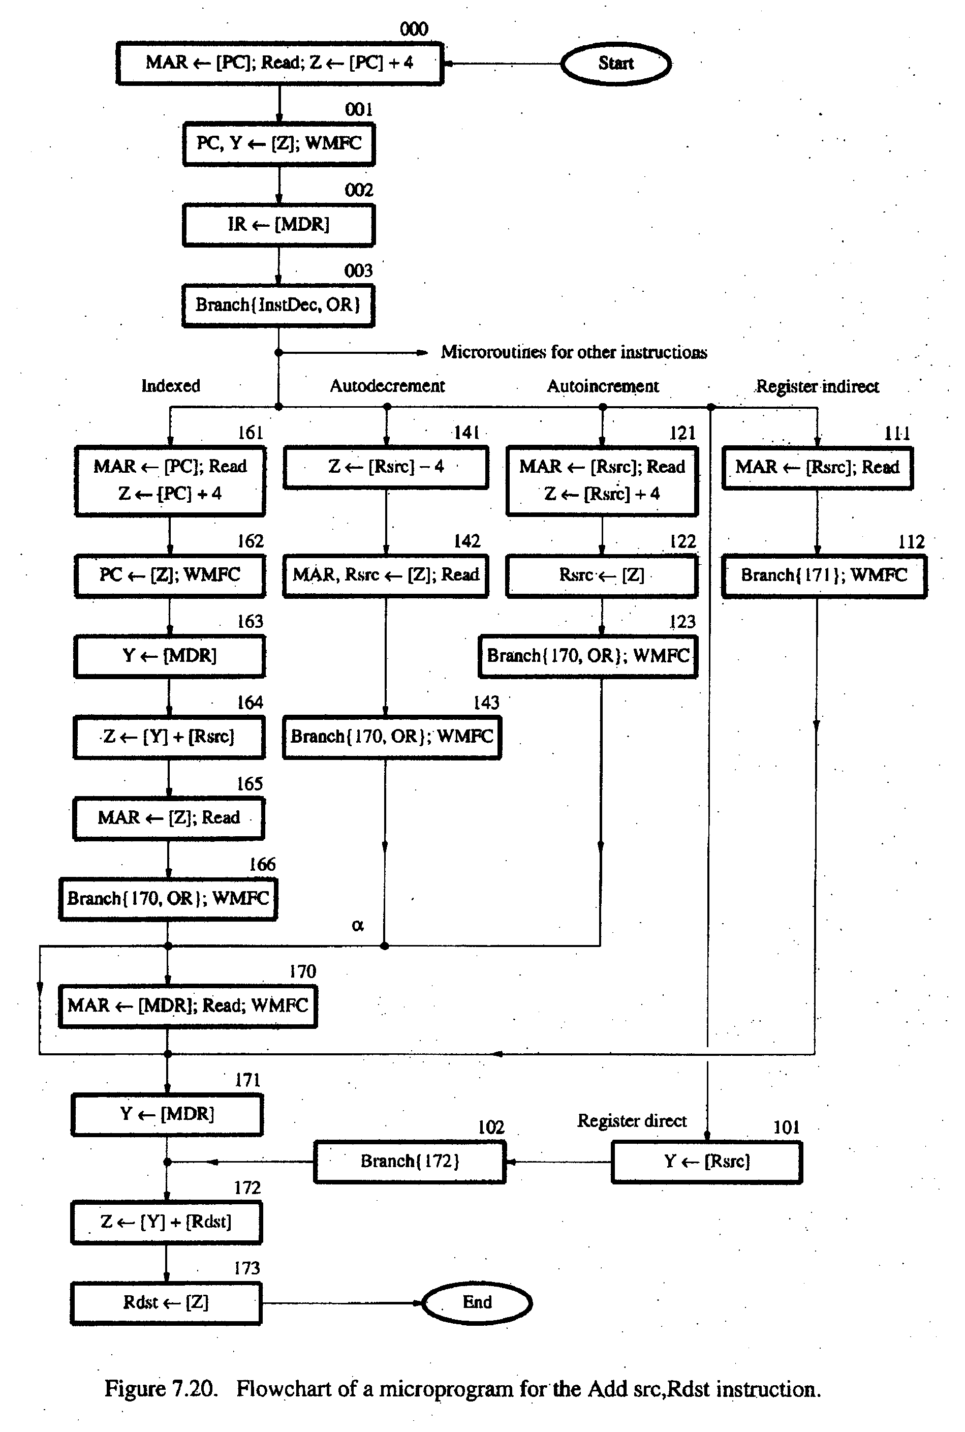
- Bit-ORing
- Wide-Branch Addressing
- WMFC

Slide 52
Mode
Contents of IR
OP code
0
1
0
Rsrc
Rdst
11
10
8
7
4
3
0
Address
Microinstruction
(octal)
000
PC
, MAR
, Read, Select
, Add, Z
out
in
4
in
001
Z
out
, PC
in
, Y
in
, WMFC
002
MDR
out
, IR
in
003
μ
Branch {
μ
PC
←
101 (from Instruction decoder);
μ
PC
5,4
←
[IR
10,9
];
μ
PC
3
←
[IR
10
]
⋅
[IR
9
]
⋅
[IR
8
]}
121
Rsrc
, MAR
, Read, Select4, Add, Z
out
in
in
122
Z
out
, Rsrc
in
123
μ
Branch {
μ
PC
←
170;
μ
PC
0
←
[IR
8
]}, WMFC
170
MDR
out
, MAR
in
, Read, WMFC
171
MDR
out
, Y
in
172
Rdst
out
, SelectY
, Add, Z
in
173
Z
out
, Rdst
in
, End
Figure 7.21.
Microinstruction for Add (Rsrc)+,Rdst.
Note:
Microinstruction at location 170 is not executed for this addressing mode.

Slide 53
Microinstructions with Next-Address Field
The microprogram we discussed requires several branch microinstructions, which perform no useful operation in the datapath.
A powerful alternative approach is to include an address field as a part of every microinstruction to indicate the location of the next microinstruction to be fetched.
Pros: separate branch microinstructions are virtually eliminated; few limitations in assigning addresses to microinstructions.
Cons: additional bits for the address field (around 1/6)

Slide 54
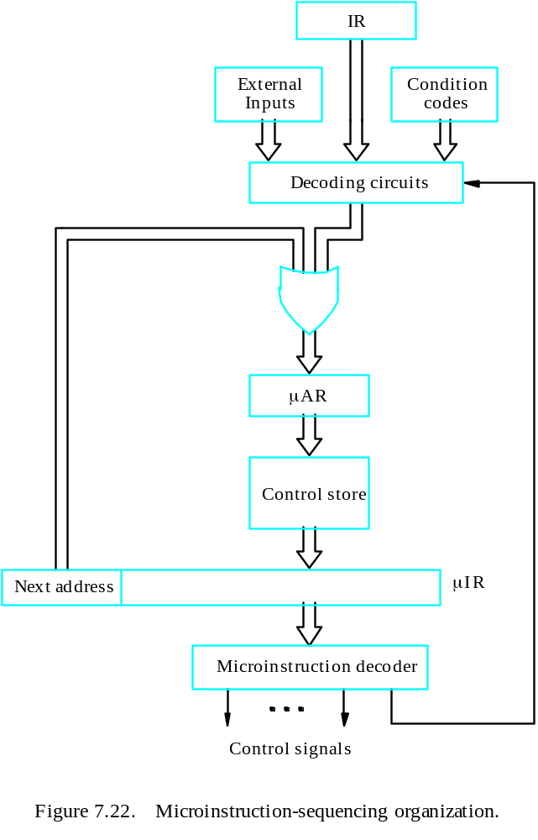
Microinstructions with Next-Address Field

Slide 55
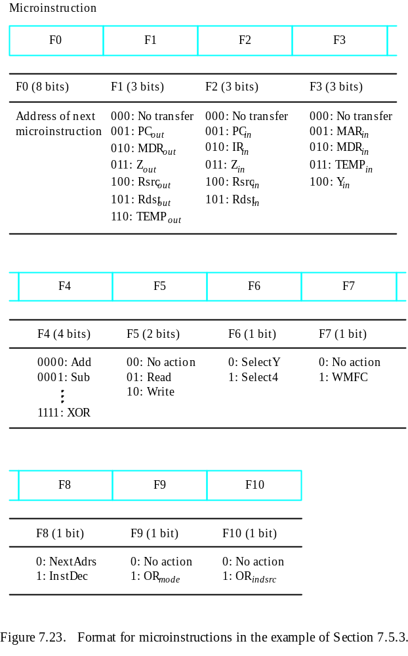

Slide 56
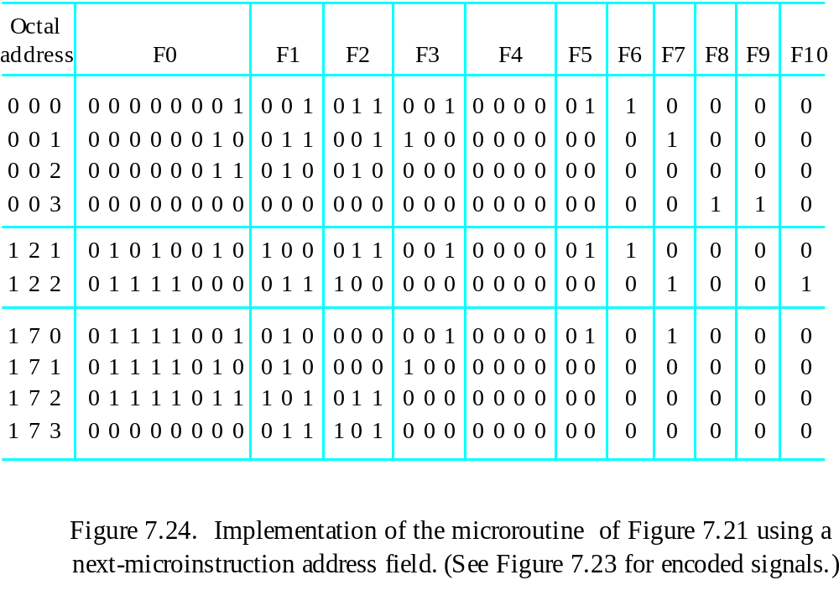
Implementation of the Microroutine

Slide 57
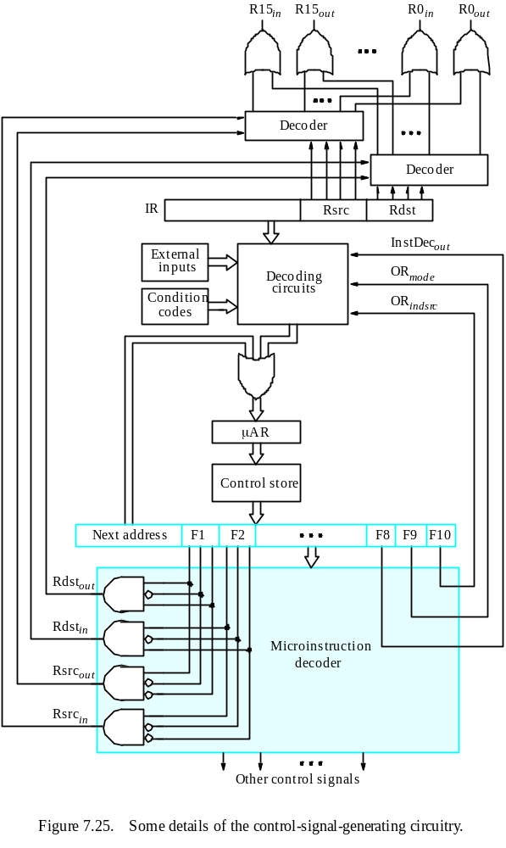

Slide 58
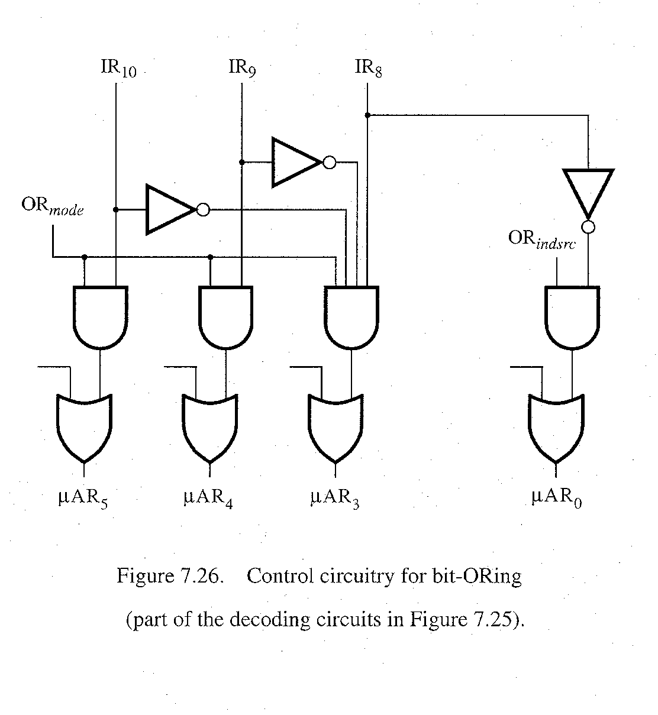
bit-ORing

Slide 59
Further Discussions
Prefetching
Emulation

